Slide 1
Interactive Brain Tumor Segmentation

Slide 2
FocalClick
Towards Practical Interactive Image Segmentation

Slide 3
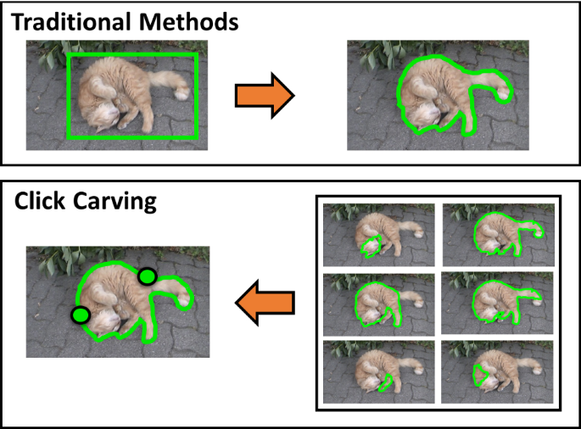
Interactions
Scribbles
Boxes
Click

Slide 4
Click based interaction
Positive = Foreground = Red points
Negative = Background = Green points

Slide 5
Previous works cons
Efficiency on low-power devices
Working with preexisting mask
Gap between academic approaches and industrial needs

Slide 6
Efficiency on low-power devices
Quick responses
Big models and high-resolution inputs

Slide 7
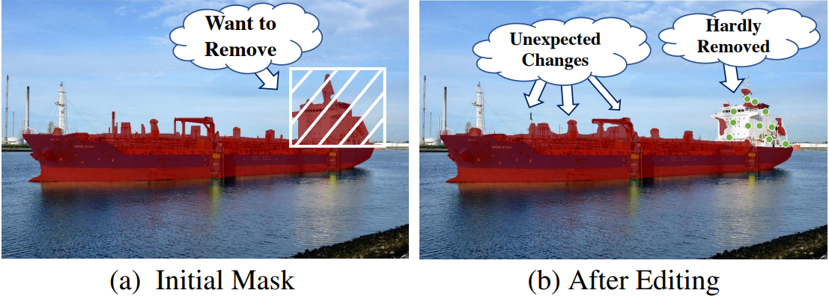
Working with preexisting mask
Don’t need to start from scratch and offline models provide them
Most works do not consider the previous mask as input

Slide 8
Make new predictions
Make new predictions equally for all pixels after each click:
Computation redundancy:
Well predicted regions would be computed repeatedly
Loss of details:
All pixels of the previous mask would be updated, making the model fail to preserve the details given in the initial masks

Slide 9
FocalClick
Focus on local area
Make predictions on the patch that really needs re-calculation
Only updates the mask in the region that the user intends to modify
Retains predictions in other regions

Slide 10
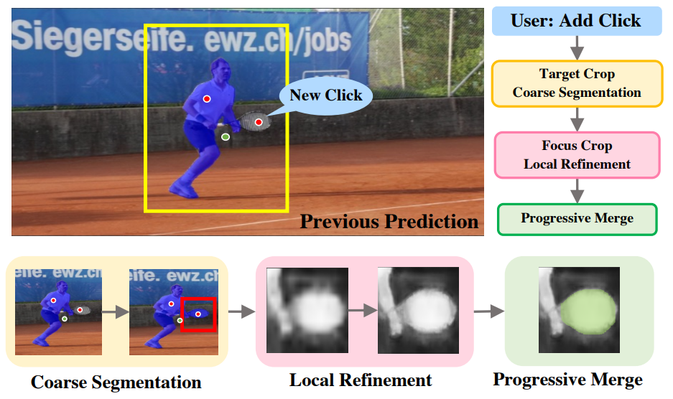
Abstract pipeline

Slide 11
Abstract pipeline
Given a new click, we first select a Target Crop according to the existing mask.
This Target Crop would be resized into low resolution and execute coarse segmentation.
Afterward, we localize a small region that the user intends to modify and send it into Refiner to extract the details.
Thus, we decompose the time-consuming full image inference into two fast local predictions.
Progressive Merge carries out morphological analysis of the previous masks and the current predictions to decide where to update and preserve. Thus, the correct part would not be destroyed.

Slide 12
Previous works also crop but…
They require to keep the resolution.
Differently, FocalClick leverages the Target Crop to locate the Focus Crop area, and does not rely on the Segmentor to produce fine details
Enabling us to resize the Target Crop to small scales for higher speed.

Slide 13
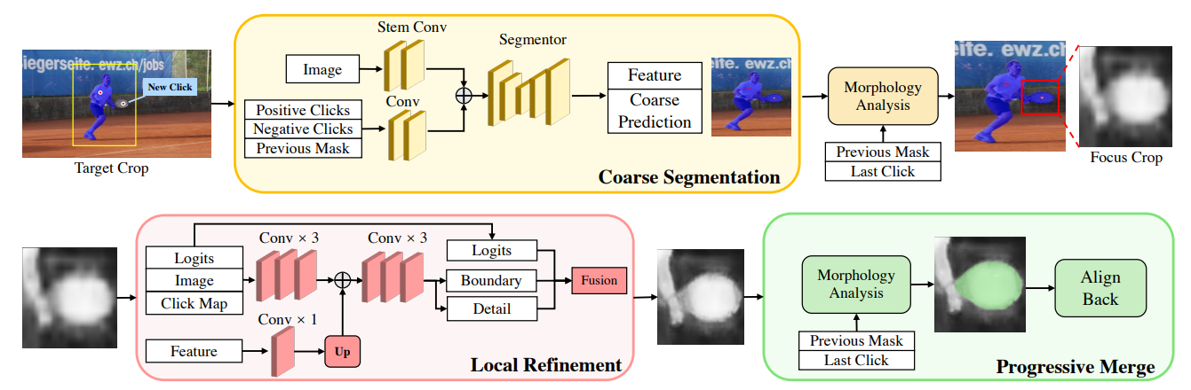
Detailed pipeline

Slide 14
Detailed pipeline
Take the image, two click maps, and the previous mask as input.
Use binary disks with radius 2 to represent the click.
Select the Target Crop around the target object and resize it to a small size.
It is then sent into Segmentor to predict a coarse mask.
Chose a Focus Crop by calculating the different regions between the previous masks and the coarse prediction to refine the details.
At last, Progressive Merge updates the local part that the user intends to modify and preserves the details in other regions.

Slide 15
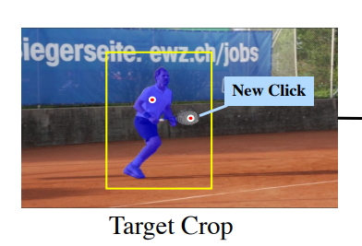
Target crop
Goal: Filter out background information that is not related to the target object
Calculate the minimum external box of the previous mask and the newly added click
Expand it with a ratio rT C = 1.4
Crop the input tensors (image, previous mask, click maps)
Resize them into small scales

Slide 16
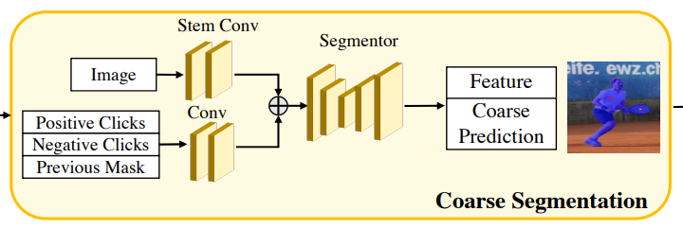
Coarse segmentation
Any segmentation network (HRNet+OCR, SegFormer)
RITM
Two conv layers to adjust the channel and scale of the click maps
Make feature fusion after the stem layers

Slide 17
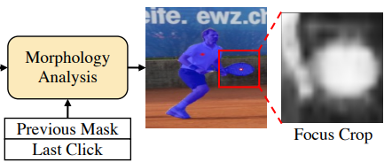
Focus crop
Compare the differences between the primitive segmentation results and the previous mask
Difference Mask (DM) by XOR operation
Calculate the max connected region of DM that contains the new click
Generate the external box for this max connected region
Similar to the Target Crop, make expansion with ratio rF C = 1.4
Crop local patches on the input image and click maps

Slide 18
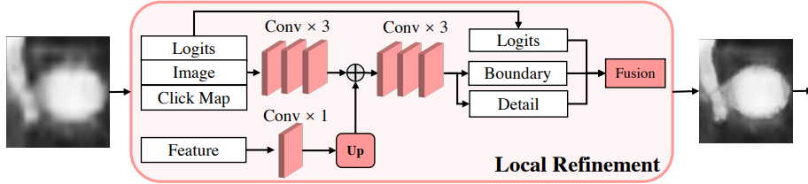
Local refinement
Recovers the details of the coarse prediction in Focus Crop
Use RoiAlign to crop the feature and the output logits predicted by the Segmentor
Extract the low-level feature from the cropped tensor using Xception convs
Adjust the channel number of the RoiAligned feature and fuse it with the extracted low-level feature
Detail map: Md Boundary map: Mb Coarse predicted logits: Ml Refined map: Mr

Slide 19
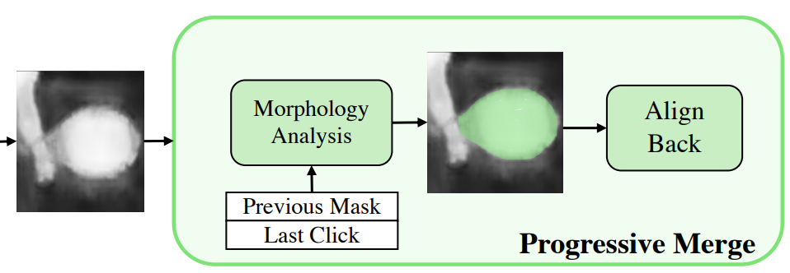
Progressive merge
Simply binarize the newly predicted mask with a threshold of 0.5
Calculate a different region between the new prediction and the preexisting mask
Pick the max connected region that contains the new click as the update region
Update the newly predicted mask onto the previous mask
Keep the previous mask untouched in other regions

Slide 20
Thank you!

Slide 21
BraTS 2020 Dataset
Samples: 369
Width: 240
Height: 240
Depth: 155
Channels (MRI Imaging Sequences): 4
NIfTI (Neuroimaging Informatics Technology Initiative) (.nii.gz)
In 2D format we have 369 * 155 = 57195 samples

Slide 22
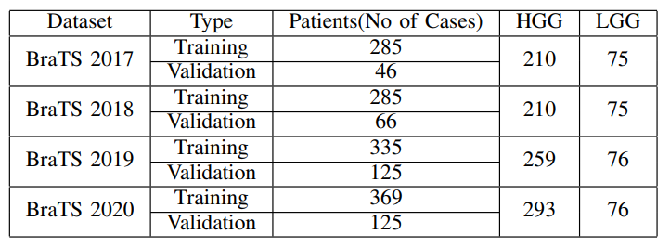
BraTS over years

Slide 23
BraTS Channels (MRI Imaging Sequences)
T2 Fluid Attenuated Inversion Recovery (T2-FLAIR): _flair.nii
Native (T1): _t1.nii
Post-contrast T1-weighted (T1Gd): _t1ce.nii T1ce: contrast-enhanced
T2-weighted (T2): _t2.nii

Slide 24
BraTS Channels (MRI Imaging Sequences)
Tissue | T1-Weighted | T2-Weighted | Flair
Cerebrospinal fluid (CSF) | Dark | Bright | Dark
White matter | Light | Dark Gray | Dark Gray
Cortex | Gray | Light Gray | Light Gray
Fat | Bright | Light | Light
Inflammation | Dark | Bright | Bright

Slide 25
BraTS Channels (MRI Imaging Sequences)
For example:
T1-weighted images highlight enhancing part of the tumor
FLAIR acquisitions highlight the peritumoral edema.

Slide 26
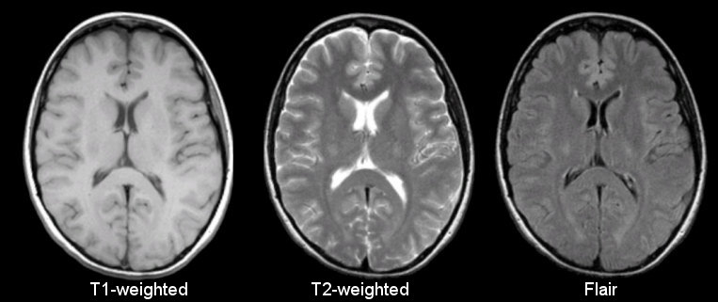

Slide 27
BraTS Channels (MRI Imaging Sequences)
The most useful channels are:
Flair
T1ce
These sequences are in grayscale
Mix approach: Stack three sequences
Like RGB -> Flair-T1ce-T2

Slide 28
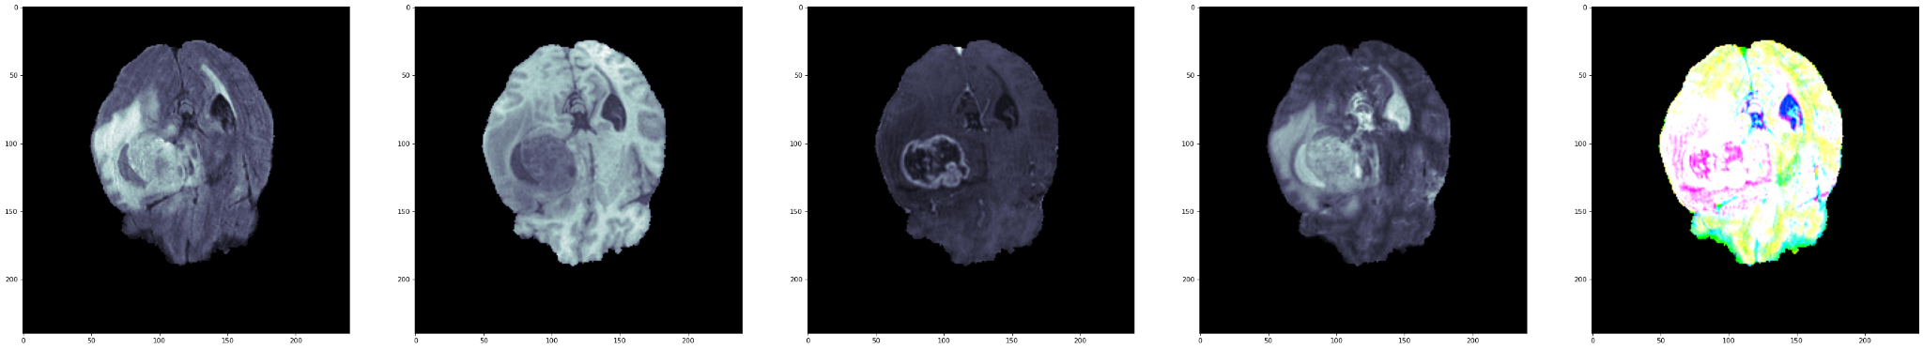
From left to right: Flair - T1 - T1ce - T2 - Mix

Slide 29
BraTS Masks
The labels in BraTS are:
Necrotic and non-enhancing tumor core (NCR/NET - Label 1)
Peritumoral edema (ED - Label 2)
GD-enhancing tumor (ET - Label 4)
New masks are obtained:
Whole Tumor (WT): NCR + ED + ET
Tumor Core (TC): NCR + ET

Slide 30
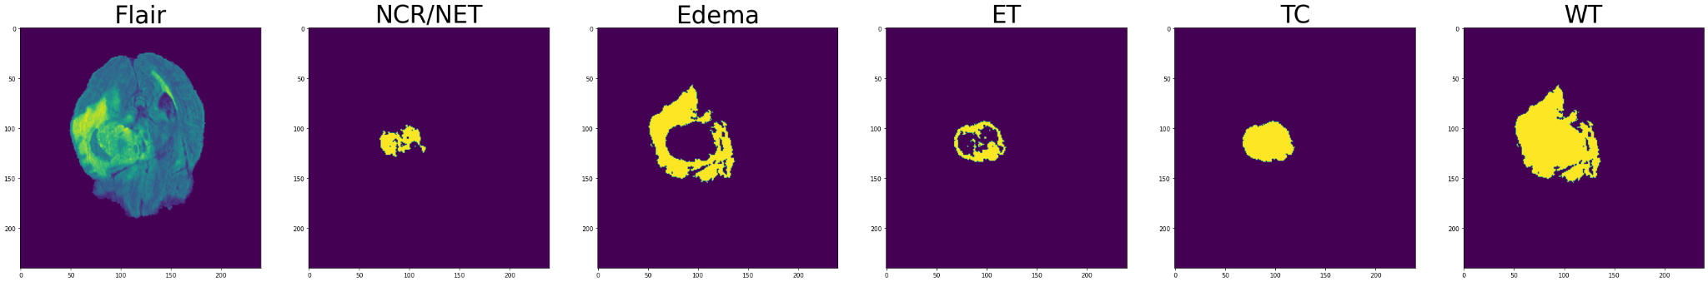

Slide 31
BraTS in papers
Brain Tumor Segmentation using Enhanced U-Net Model with Empirical Analysis (2022)
Train: 68 %
Validation: 20 %
Test: 12 %
BraTS 2019
In 2D network: Flair + T1ce
In 3D network: Flair + T1ce + T2
Evaluation on all masks.

Slide 32
BraTS in papers
DeepIGeoS: A Deep Interactive Geodesic Framework for Medical Image Segmentation (2017)
BraTS 2015 (3D)
Only Flair
Train: 234 cases (85 %)
Validation: 40 cases (15 %)
Mask: WT

Slide 33
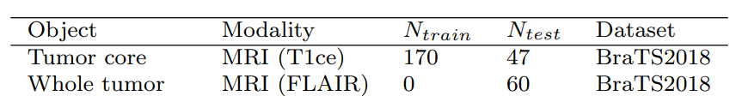
BraTS in papers
MIDeepSeg: Minimally Interactive Segmentation of Unseen Objects from Medical Images Using Deep Learning (2021)
BraTS 2018 (3D)
Only T1ce
Train: 170 cases (78 %)
Validation: 47 cases (22 %)
Mask: TC
New unseen task: WT (Flair)

Slide 34
BraTS Resources
BraTS 2020 in NIfTI format: 43 GB
https://www.kaggle.com/datasets/awsaf49/brats20-dataset-training-validation
BraTS 2020 in h5 format: 8 GB
https://www.kaggle.com/datasets/awsaf49/brats2020-training-data
https://drive.google.com/drive/folders/1-IIgbC_AEJqRly6nPnDs99ljGnPIzeSc?usp=share_link
Working with BraTS notebook
https://drive.google.com/file/d/1Ga9qVTMigj93oEPHSPmubJRvSBJAk_SN/view?usp=sharing
In this work we used the second version

Slide 35
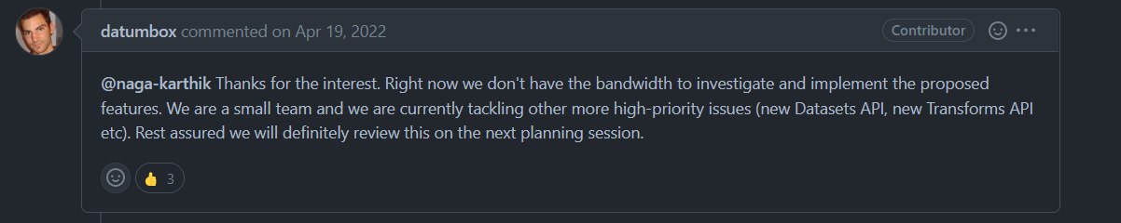
Focal Click
High resolution images - Volume Slicing
Refiner and Segmentor input is 256*256 (cropping)
BraTS is 240 * 240 * 155
RGB and 2D specific
Many 2D component: PyTorch RoI Align
https://github.com/pytorch/vision/issues/2402

Slide 36
Metrics

Slide 37

IoU (Intersection over Union) - Jaccard Index
intersection = np.logical_and(np.logical_and(pred_mask, obj_gt_mask), ignore_gt_mask_inv).sum()
union = np.logical_and(np.logical_or(pred_mask, obj_gt_mask), ignore_gt_mask_inv).sum()
intersection / union

Slide 38
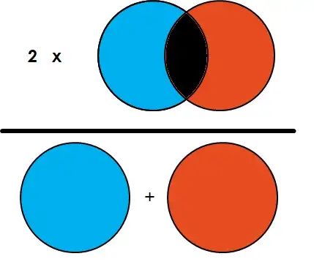
Dice (F1 Score)
intersection = np.logical_and(np.logical_and(pred_mask, obj_gt_mask), ignore_gt_mask_inv).sum()
sum_area = np.sum(pred_mask) + np.sum(obj_gt_mask)
2 * intersection / sum_area

Slide 39
IoU vs Dice
In segmentation tasks, Dice Coeff (Dice loss = 1-Dice coeff) is used as a Loss function because it is differentiable where as IoU is not differentiable.
Both can be used as metric to evaluate the performance of your model but as a loss function only Dice is used

Slide 40
NoC, NoF, TPC, mIoU, mDICE
NoC: Number of Click to reach desired IoU or Dice score
NoF: Number of Failed samples within max_click param to reach desired IoU or Dice score
TPC: Response time (new segmentation) per click (second)
mIoU: Mean IoU score with an specific number of clicks
mDICE: Mean Dice score with an specific number of clicks

Slide 41
Experiments

Slide 42
Data splitting
Training:
75 %
276 cases
42780
Validation:
20 %
73 cases
11315
Test:
5 %
18 cases
2790

Slide 43
Common Setting
Epochs: 20
Batch size: 32
Crop size: 96 * 96
Infer size: 96 * 96
Target crop ratio: 1.4
Focus crop ratio: 1.4
GPU: Kaggle P100

Slide 44
CDNet-ResNet34-Flair-WT-Pretrained
Model: CDNet
Backbone: DeepLabv3+ with Gluon ResNet34 v1b
Pretrained: True
Channel: Flair
Mask : WT
Eval checkpoint: Last
Eval Channel: Flair
Eval Label: WT

Slide 45
CDNet-ResNet34-Flair-WT-Pretrained
Metric | NoC80% | NoC85% | NoC90% | NoF85% | NoF90% | TPC | TIME
IoU | 7.87 | 8.65 | 9.18 | 1087 | 1165 | 0.123 | 1:54:13
Dice | 6.13 | 7.10 | 8.15 | 851 | 1013 | 0.123 | 1:54:13
Metric | C=1 | C=2 | C=3 | C=5 | C=10 | C=20
mIoU | 65.58 % | 54.83 % | 55.35 % | 57.42 % | 58.65 % | 60.24 %
mDICE | 70.84 % | 56.17 % | 56.26 % | 58.33 % | 59.82 % | 62.01 %

Slide 46
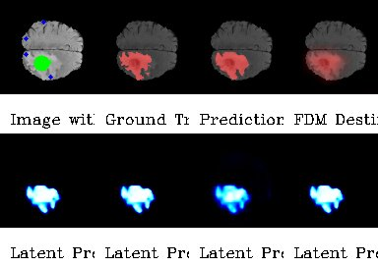
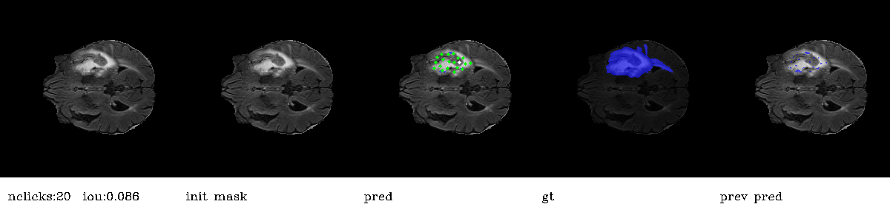

Slide 47
FocalClick-HRNet18s-Flair-WT-Pretrained
Model: FocalClick
Backbone: HRNet18s
Pretrained: True
Channel: Flair
Mask : WT
Eval checkpoint: Last
Eval Channel: Flair
Eval Label: WT

Slide 48
FocalClick-HRNet18s-Flair-WT-Pretrained
Metric | NoC80% | NoC85% | NoC90% | NoF85% | NoF90% | TPC | TIME
IoU | 3.47 | 4.31 | 6.00 | 325 | 568 | 0.061 | 0:56:38
Dice | 2.50 | 2.92 | 3.72 | 180 | 259 | 0.061 | 0:56:38
Metric | C=1 | C=2 | C=3 | C=5 | C=10 | C=20
mIoU | 84.27 % | 85.77 % | 86.59 % | 88.08 % | 89.79 % | 90.94 %
mDICE | 88.39 % | 89.67 % | 90.28 % | 91.36 % | 92.63 % | 93.55 %

Slide 49
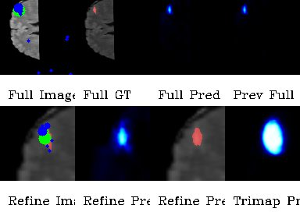
Full Image, Full GT, Full Pred, Prev Full Pred
Refine Image, Refine Pred, Refine Pred, Trimap Pred

Slide 50
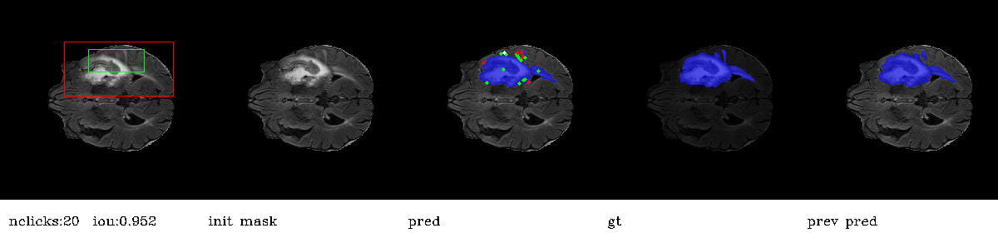
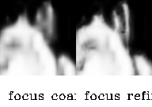
Focus Coarse, Focus Refined

Slide 51
FocalClick-HRNet32-Flair-WT-Pretrained
Model: FocalClick
Backbone: HRNet32
Pretrained: True
Channel: Flair
Mask : WT
Eval checkpoint: Last
Eval Channel: Flair
Eval Label: WT

Slide 52
FocalClick-HRNet32-Flair-WT-Pretrained
Metric | NoC80% | NoC85% | NoC90% | NoF85% | NoF90% | TPC | TIME
IoU | 4.23 | 5.11 | 6.53 | 515 | 697 | 0.103 | 1:35:37
Dice | 3.02 | 3.53 | 4.52 | 326 | 443 | 0.103 | 1:35:37
Metric | C=1 | C=2 | C=3 | C=5 | C=10 | C=20
mIoU | 85.58 % | 79.77 % | 79.02 % | 79.39 % | 80.66 % | 81.69 %
mDICE | 89.03 % | 82.69 % | 81.84 % | 81.65 % | 82.46 % | 83.34 %

Slide 53
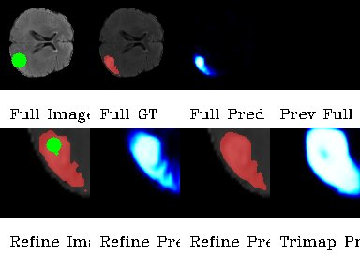

Slide 54
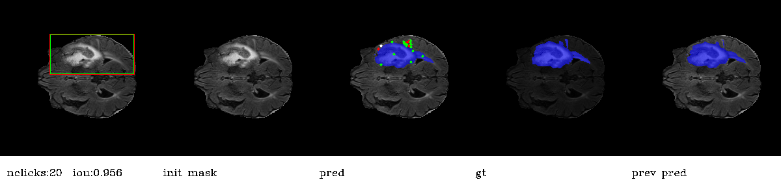
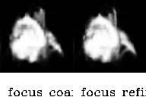

Slide 55
FocalClick-SegFormerB3-Flair-WT-Pretrained
Model: FocalClick
Backbone: SegFormerB3
Pretrained: True
Channel: Flair
Mask : WT
Eval checkpoint: Last
Eval Channel: Flair
Eval Label: WT

Slide 56
FocalClick-SegFormerB3-Flair-WT-Pretrained
Metric | NoC80% | NoC85% | NoC90% | NoF85% | NoF90% | TPC | TIME
IoU | 3.28 | 4.03 | 5.75 | 320 | 530 | 0.059 | 0:55:07
Dice | 2.45 | 2.81 | 3.48 | 176 | 246 | 0.059 | 0:55:07
Metric | C=1 | C=2 | C=3 | C=5 | C=10 | C=20
mIoU | 85.35 % | 85.30 % | 86.46 % | 88.37 % | 90.29 % | 91.75 %
mDICE | 88.96 % | 88.84 % | 89.75 % | 91.16 % | 92.78 % | 94.12 %

Slide 57
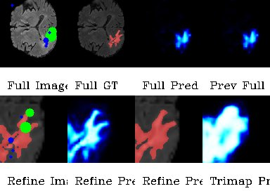

Slide 58
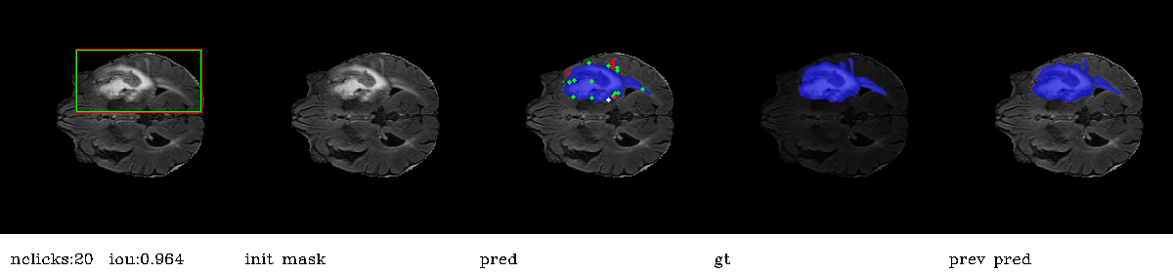
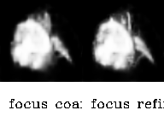

Slide 59
FocalClick-SegFormerB3-Mix-WT
Model: FocalClick
Backbone: SegFormerB3
Pretrained: False
Channel: Mix (Flair, T1ce, T2)
Mask : WT
Eval checkpoint: Best (Epoch 16)
Eval Channel: Flair
Eval Label: WT

Slide 60
FocalClick-SegFormerB3-Mix-WT
Metric | NoC80% | NoC85% | NoC90% | NoF85% | NoF90% | TPC | TIME
IoU | 3.24 | 4.15 | 5.63 | 319 | 533 | 0.061 | 0:56:54
Dice | 2.21 | 2.66 | 3.53 | 138 | 233 | 0.061 | 0:56:54
Metric | C=1 | C=2 | C=3 | C=5 | C=10 | C=20
mIoU | 86.17 % | 87.31 % | 88.36 % | 89.73 % | 91.74 % | 93.07 %
mDICE | 89.57 % | 90.86 % | 91.74 % | 92.82 % | 94.49 % | 95.56 %

Slide 61
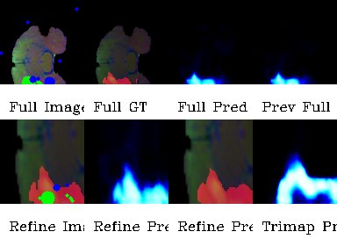

Slide 62
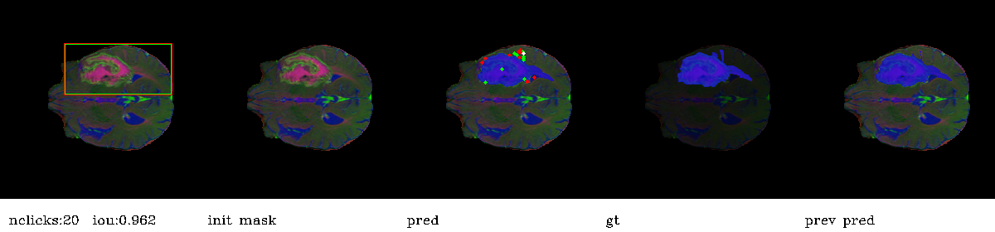
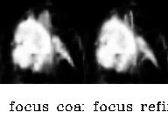

Slide 63
Unseen Tasks

Slide 64
FocalClick-SegFormerB3-Flair-WT-Pretrained--Flair-TC
Model: FocalClick
Backbone: SegFormerB3
Pretrained: True
Channel: Flair
Mask : WT
Eval checkpoint: Last
Eval Channel: Flair
Eval Label: TC

Slide 65
FocalClick-SegFormerB3-Flair-WT-Pretrained--Flair-TC
Metric | NoC80% | NoC85% | NoC90% | NoF85% | NoF90% | TPC | TIME
IoU | 5.96 | 6.39 | 6.82 | 667 | 790 | 0.059 | 0:54:53
Dice | 4.93 | 5.49 | 6.13 | 456 | 596 | 0.059 | 0:54:53
Metric | C=1 | C=2 | C=3 | C=5 | C=10 | C=20
mIoU | 78.04 % | 78.29 % | 78.96 % | 80.30 % | 82.85 % | 86.92 %
mDICE | 81.76 % | 82.12 % | 82.71 % | 83.83 % | 86.09 % | 89.75 %

Slide 66
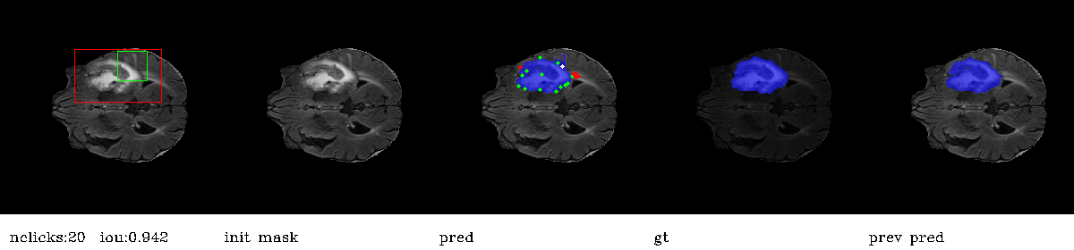
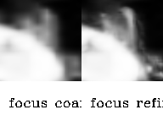

Slide 67
FocalClick-SegFormerB3-Flair-WT-Pretrained--T1ce-TC
Model: FocalClick
Backbone: SegFormerB3
Pretrained: True
Channel: Flair
Mask : WT
Eval checkpoint: Last
Eval Channel: T1ce
Eval Label: TC

Slide 68
FocalClick-SegFormerB3-Flair-WT-Pretrained--Flair-TC
Metric | NoC80% | NoC85% | NoC90% | NoF85% | NoF90% | TPC | TIME
IoU | 4.56 | 4.87 | 5.42 | 480 | 576 | 0.058 | 0:54:22
Dice | 4.20 | 4.38 | 4.68 | 421 | 458 | 0.058 | 0:54:22
Metric | C=1 | C=2 | C=3 | C=5 | C=10 | C=20
mIoU | 79.80 % | 79.27 % | 80.06 % | 81.31 % | 82.96 % | 85.49 %
mDICE | 81.52 % | 80.77 % | 81.47 % | 82.58 % | 84.21 % | 86.77 %

Slide 69
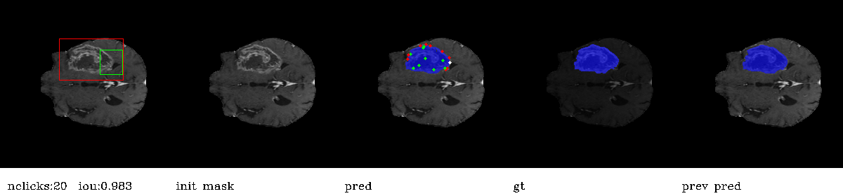
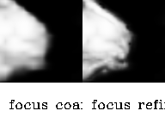

Slide 70
Result of other papers

Slide 71
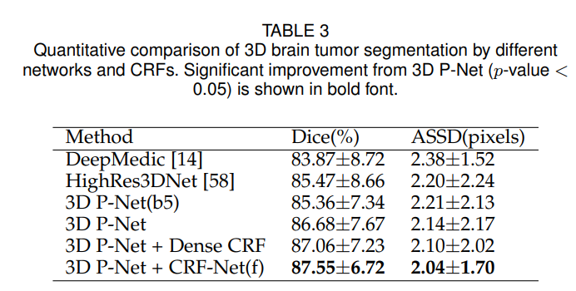
DeepIGeoS

Slide 72
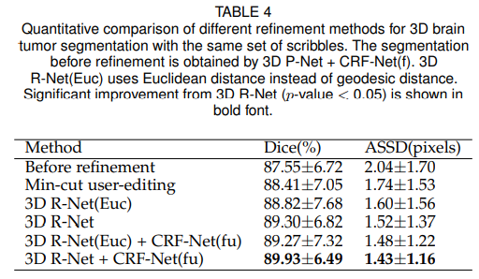
DeepIGeoS

Slide 73
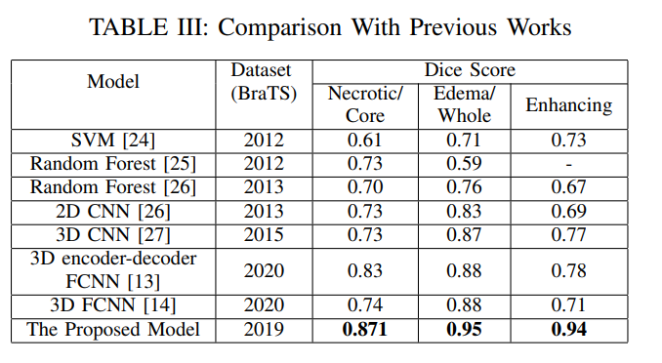
Enhanced U-Net

Slide 74
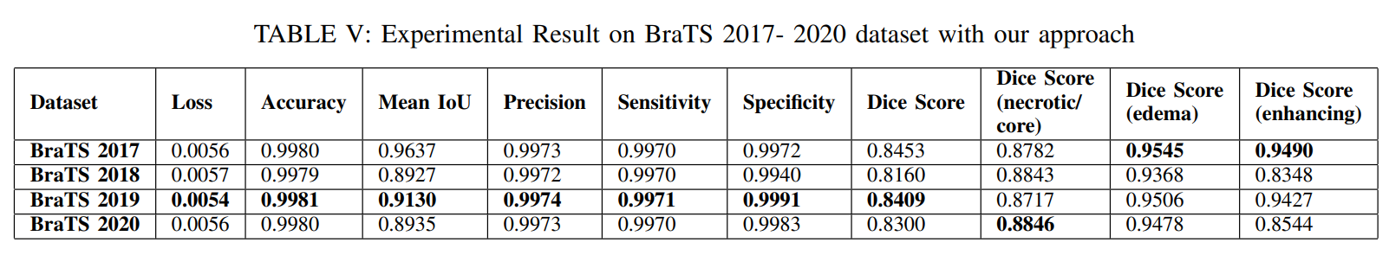
Enhanced U-Net

Slide 75
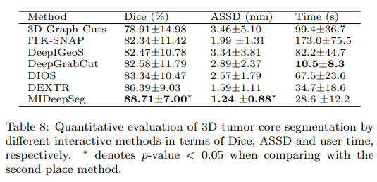
MIDeepSeg

Slide 76
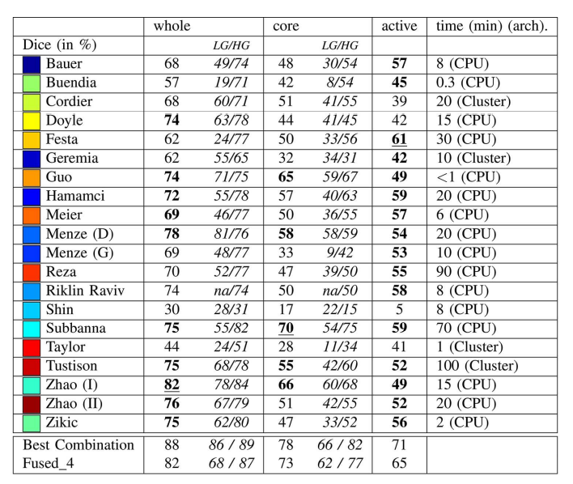

Slide 77
Links

Slide 78
Google Drive
Articles
Experiments and Results
Notebooks
Reports
https://drive.google.com/drive/folders/13oMr0yZt6DzFQW2nn8vOl6YrTPsDYbam?usp=share_link

Slide 79
GitHub
Implementation of CDNet
Implementation of FocalClick
BraTS data loaders
https://github.com/ali-sedaghi/Interactive-BraTS

